Slide 1


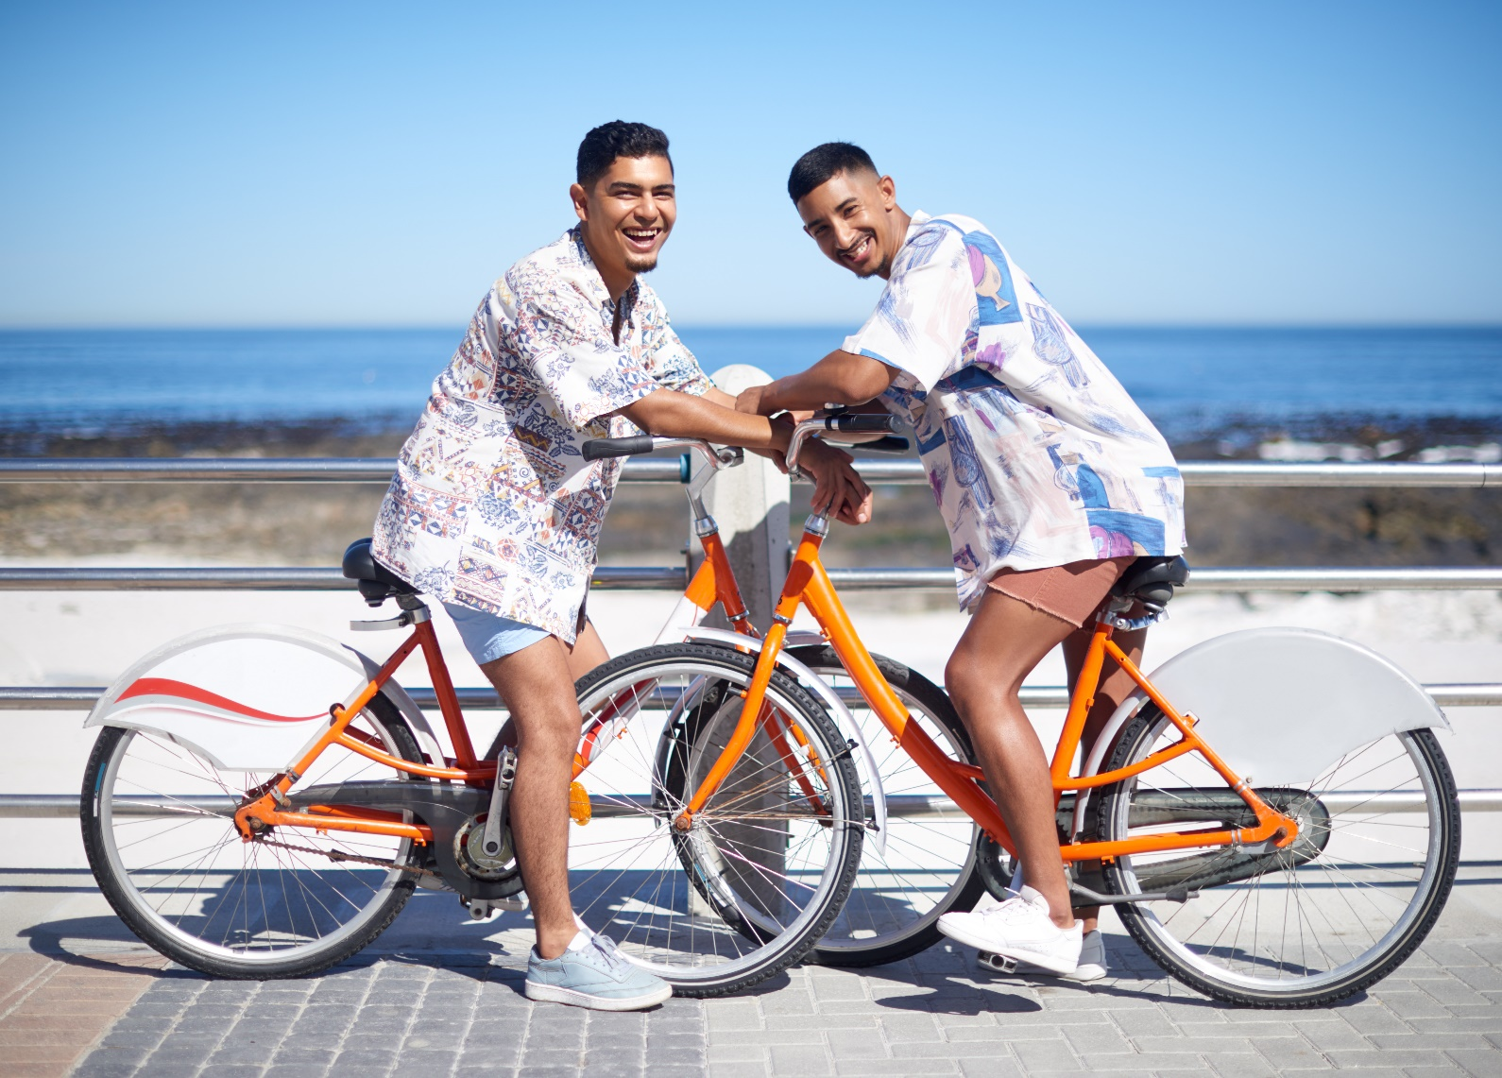
ADVENTURE HARDWARE GROUP DATA VISUALIZATION & FORECASTING
DELIVERED BY JUSTIN ARHEBAMHEN ON BEHALF OF PAIRVIEW LIMITED

Slide 2


Contents
Business Overview
Executive Summary
Financial and Demographics performance
Market Share & Competitors
Market Basket Analysis
5 Years Sales Forecast
AHG Strategy
Conclusion, Recommendations & Acknowledgements

Slide 3

Business Overview

Slide 4
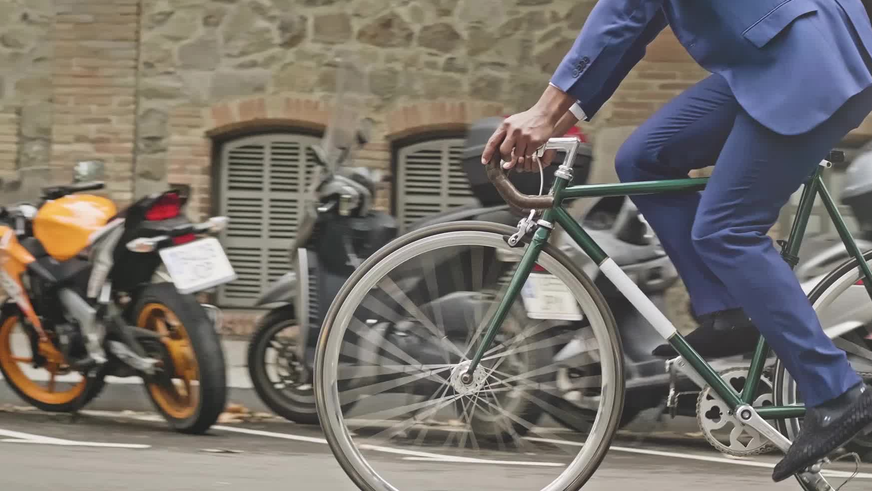
Business Overview
Adventure Hardware Group (AHG) is a global manufacturing organization with Resellers in Canada, North America, Europe, and Australia. As a specialty retailer and reseller, AHG offers a wide range of road bikes, mountain bikes, touring bikes, components, accessories, and clothing.

Slide 5








Business overview
4 years in Business
3 Continents
10 Regions
2 Channels (Online & Reseller)
4 Product Categories
35 Subcategories
19,119 Customers

Slide 6

Executive summary

Slide 7

EXECUTIVE SUMMARY
AHG's revenue was generated through the Reseller channel, contributing 73.2%, with Online sales accounting for 26.7%.
The profit distribution by sales channel reflects 96% from Online sales and 4% from the Reseller channel.
Between 2011 and 2013, both Online and Reseller channels saw increased revenue growth, with Online at 175% and Reseller at 266.7%.
The online channel’s profit grew by 181.25%, while the Reseller channel experienced a 175% decrease in profit growth during this period.
Discounted revenue rose by 528.5% from 2011 to 2012 and 136.9% from 2012 to 2013 but remained significantly lower than undiscounted revenue, which was 3873.3% higher in 2011, 1802.6% higher in 2012, and 825.5% higher in 2013.
AHG experienced losses of over $367k in 2012 and $555k in 2013 from discounts, indicating that the discount strategy is not beneficial to AHG’s profitability.
Digital Shift: Online transactions experienced a remarkable surge, increasing by approximately 276% from 533 to 2,007, while Store transactions declined by about 48% from 186 to 96. In parallel, Online orders increased by 248%, emphasizing a clear preference for the Online channel over the Reseller channel during this period.
Online customer demographics experienced significant changes from 2011 to 2013:
Both genders grew by 777.6%.
Married customers increased by 888%, outpacing singles.
Higher education levels, particularly Bachelor's degrees increased by 283% between 2012 and 2013.
The 50-60 Years age group saw the most significant increase (294% between 2012 and 2013).
Significant online customer growth in specific regions, including Australia, Canada, France, Germany, the Northwest US, and the United Kingdom.

Slide 8
EXECUTIVE SUMMARY
Market Basket Analysis:
Water Bottle & Mountain Bottle Cage: Achieve a 200% increase in profit.
Long-Sleeve Logo Jersey & Half-Finger Gloves: Unlock a 133% increase in profit.
Sport-100 & Long-Sleeve Logo Jersey: Experience a 52% boost in profit.
5-Year Sales Forecast:
Online: UK (206%), Southwest US (186%), Southeast US (420%), Northwest US (156%), Northeast US (100%), Germany (189%), France (249%), Canada (112%), Australia (126%) show increments in revenues over the years while Central US sales journeyed to the negative over time.
Reseller: These regions showed promising growth over time; UK (400%), Southwest US (364%), Northwest US (525%), Northeast US (204%), France (900%), Central (234%), Canada (189%) except Southeast US, Germany, and Australia that experienced significant declines in revenues.

Slide 9

SUMMARY OF FINANCIALS

Slide 10
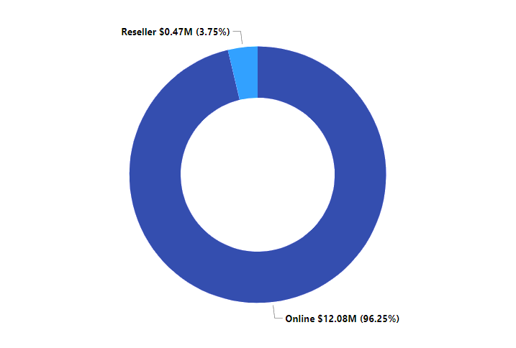
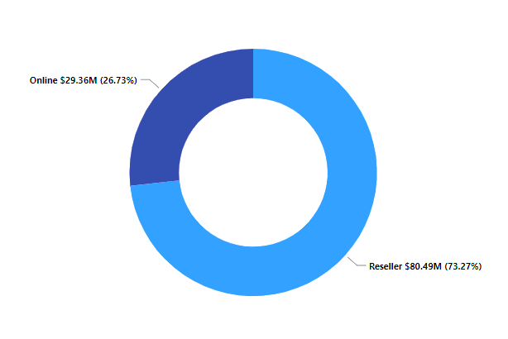
profit by sales channel
Revenue by sales channel
Revenue distribution by sales channel: Online - 26.7%, Reseller - 73.2%.
Profit distribution by sales channel: Online - 96%, Reseller - 4%.

Slide 11
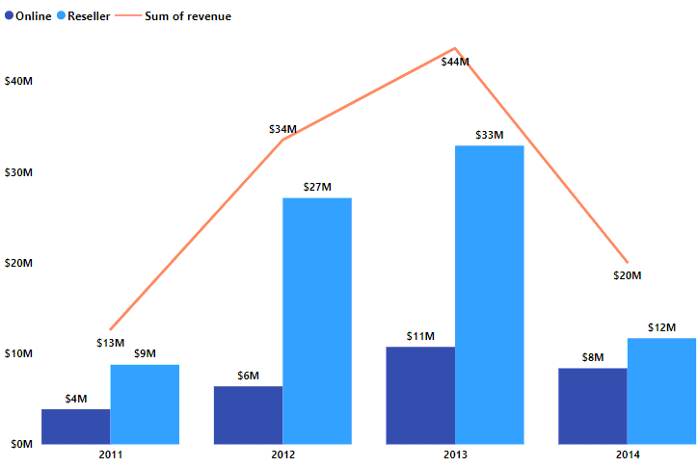
revenue growth rate
Online Channel:
2011 to 2012: Revenue up 65.35%
2012 to 2013: Revenue up 68.03%
Reseller Channel:
2011 to 2012: Revenue up 208.08%
2012 to 2013: Revenue up 21.03%

Slide 12
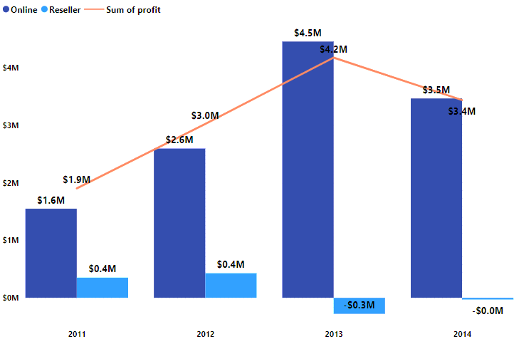
profit growth rate
Online channel profit increased by about 67.42% from 2011 to 2012 and approximately 71.71% from 2012 to 2013.
In the Reseller channel, profit rose by around 21.62% from 2011 to 2012 but declined by roughly 165.38% from 2012 to 2013.

Slide 13
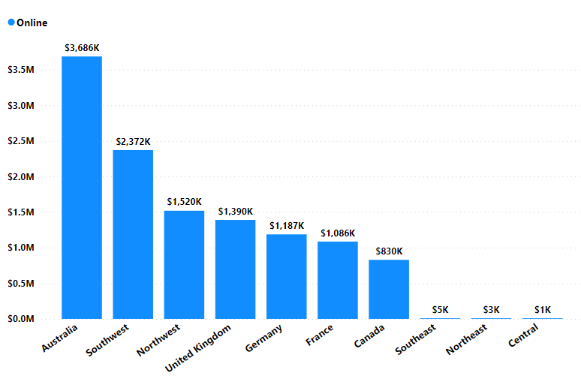
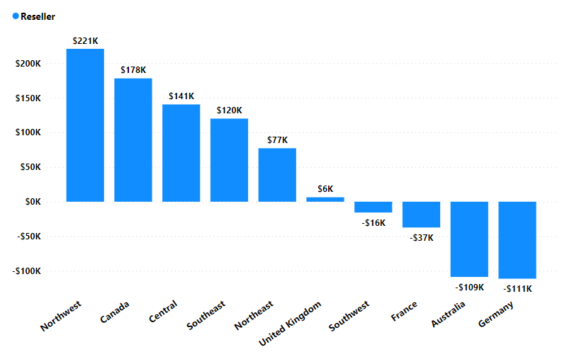
ONLINE PROFIT BY REGION
reseller profit by region
Highest Online profit
Loss Areas
Least Profit
Online profits: Australia leads at $3.6M, Southwest follows at $2.37M; Southeast $5k, Northeast at $3k, and Central at $1k show lower figures
Reseller profits: Northwest leads at $221k, Canada follows at $178k; Southwest, France, Australia, and Germany all incurred losses

Slide 14
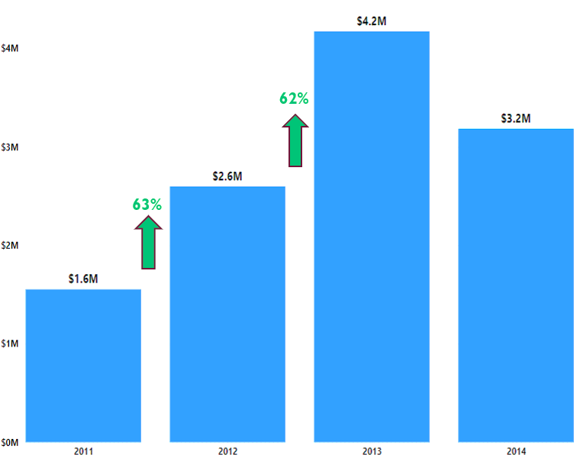
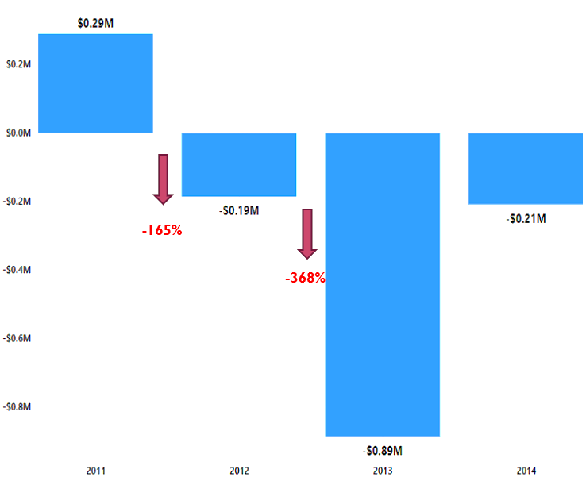
online bikes profit
reseller bikes profit
Online Bike profit increased by 63% between 2011 and 2012, and by 62% between 2012 and 2013.
Profits dropped for Reseller Bikes by -165.5% from 2011 to 2012 and -368% from 2012 to 2013.

Slide 15
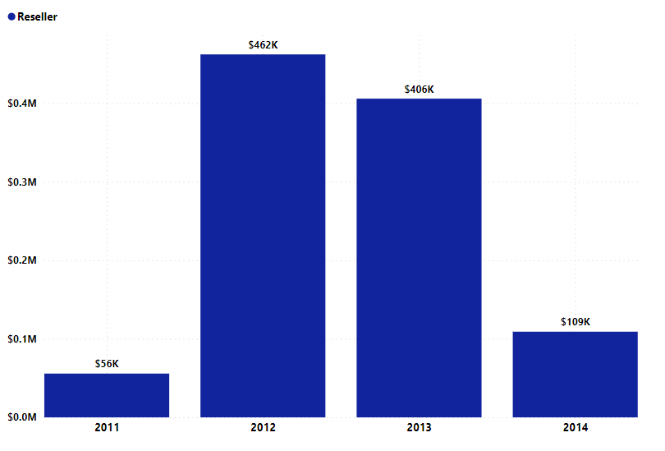
components profit – reseller only
Components’ profits for the years 2011, 2012, and 2013 are $56k, $462k, and $406k respectively.
From 2011 to 2012, profit increased by 725% and decreased by 12.1% between 2012 and 2013
There is no Components for the Online Channel

Slide 16
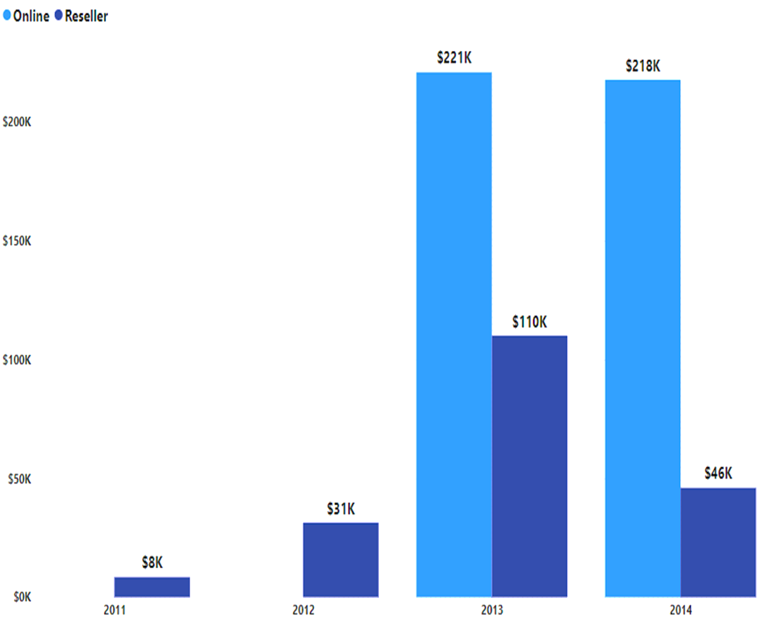
accessories profit – online & reseller
Reseller: Profits grew by 287.5% between 2011 and 2012 and 255% between 2012 and 2013.
Online: Profit was $221k in the year it was introduced.

Slide 17

Is the business making a profit?
The business is profitable, especially online, with steady profit growth, but Reseller profitability varies by region and product.

Slide 18

Pricing & discounting policy analysis

Slide 19
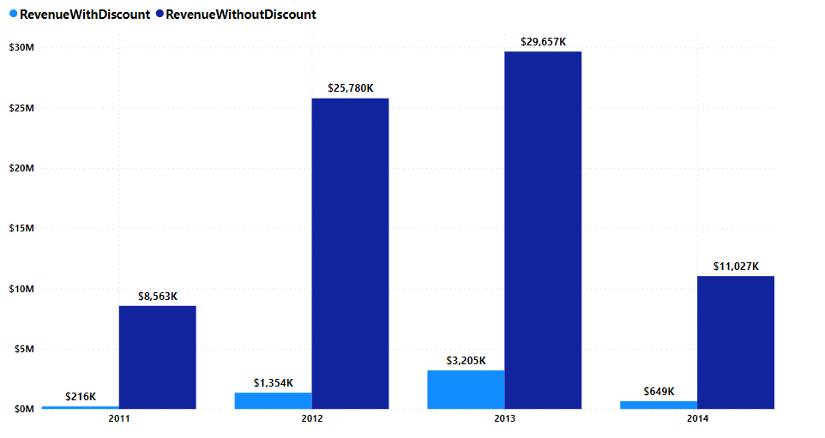
the Influence of Discounts on Revenue Trends
Discounted revenue rose by 528.5% from 2011 to 2012 and 136.9% from 2012 to 2013 but remained significantly lower than undiscounted revenue, which was 3873.3% higher in 2011, 1802.6% higher in 2012, and 825.5% higher in 2013

Slide 20
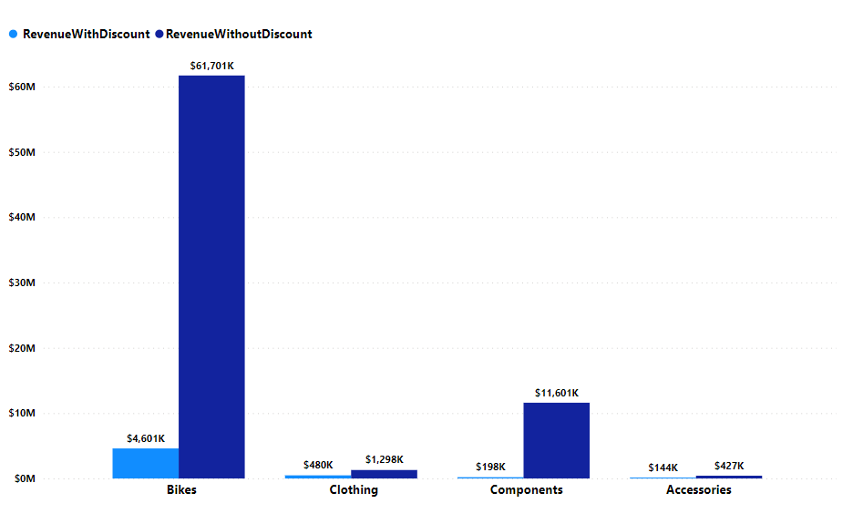
the Influence of Discounts on revenue Trends
Bikes Revenue without discount contributed 76.69% of the total revenue whereas Bikes with revenue contributed only 5.72%
Accessories Revenue with discount contributed the least to revenue (0.18%)

Slide 21
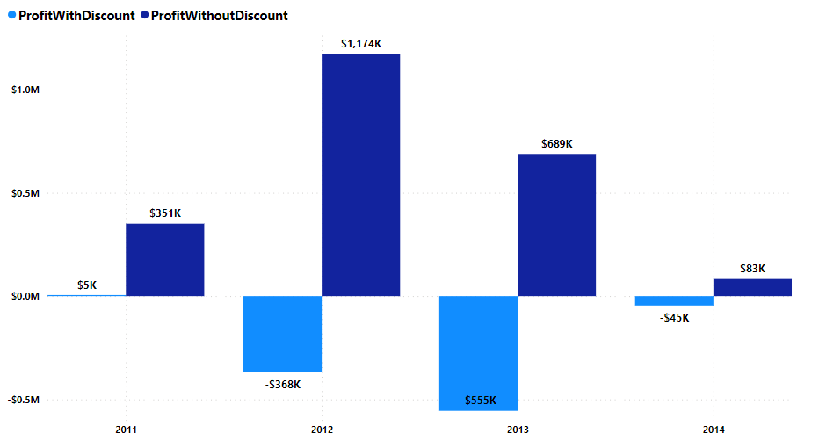
the Influence of Discounts on profit Trends
AHG experienced losses of over $367k in 2012 and $555k in 2013 from discounts, indicating the discount strategy is not beneficial to AHG’s profitability.

Slide 22
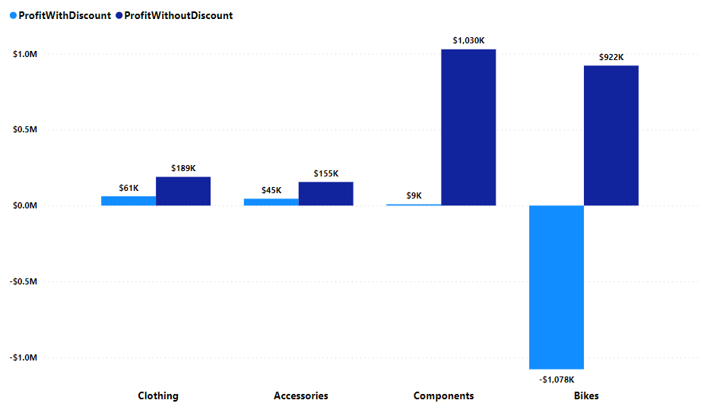
the Influence of Discounts on profit Trends
﻿At $61k, Clothing had the highest ProfitWithDiscount and is 105.68% higher than Bikes, which has the lowest ProfitWithDiscount at -$1M.
%Contribution of discounted products to overall profits include Accessories: 1.88%, Bikes: -45%, Clothing: 2.54%, and Components: 0.35%

Slide 23
Pricing & discounting policy analysis Non-discounted Sales Outperform Discounted Sales, Raising Concerns About the Efficacy of the Discount Strategy.

Slide 24

Is there a shift towards the digital?

Slide 25
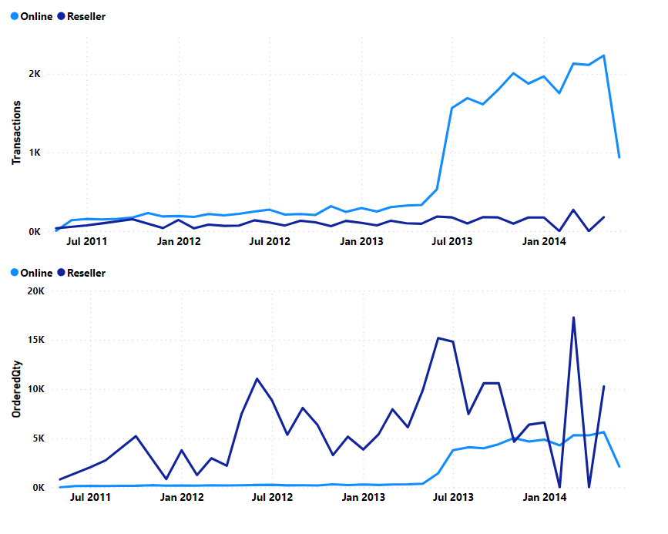
Is there a shift towards the digital?
June 2013
Nov 2013
277%
﻿Online transactions surged from 533 to 2,007, while Store transactions declined from 186 to 96 between June and November 2013.
Online orders increased by 248%, while Store orders dropped by 69% between June and November 2013.
48%
June 2013
Nov 2013
69%
248%

Slide 26
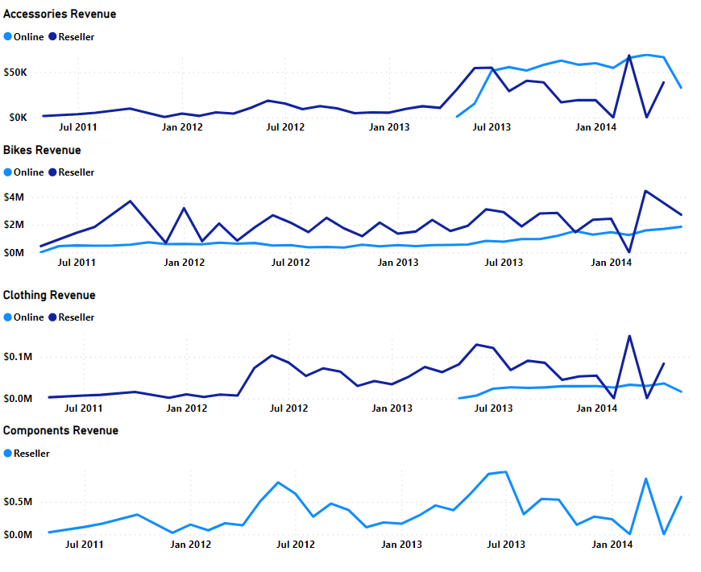
Is there a shift towards the digital?
July 2013
Nov 2013
Nov 2013
﻿Accessories and clothing were introduced in May 2013 and by July 2013 their revenues had increased by 5,401.8% and 7,836% respectively.
48%
June 2013
Nov 2013
July 2013
69%
248%
New market opportunity for Online channel

Slide 27
Is there a shift towards the digital?
YES, there has been a significant shift toward online channels compared to Resellers over the years.

Slide 28

Online customer demographics

Slide 29
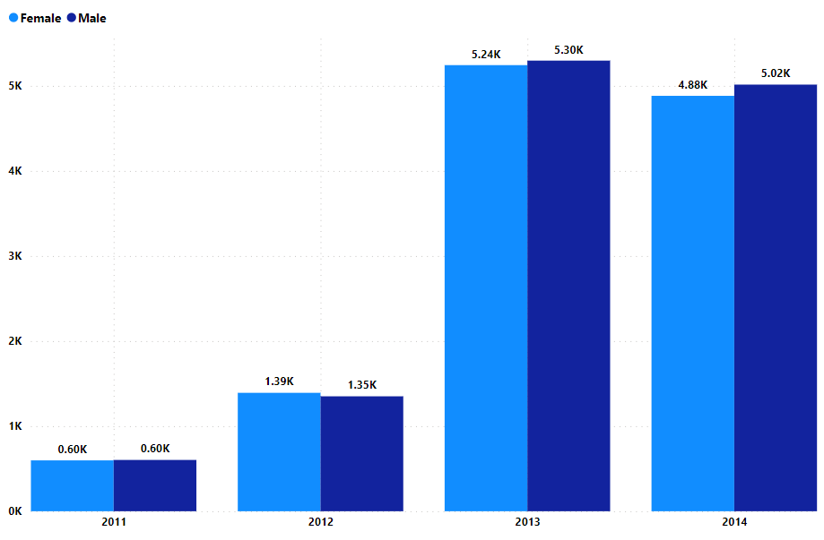
Online customer demographics: gender
July 2013
Nov 2013
Nov 2013
﻿Females increased by 132.8% between 2011 and 2012 and 276.7% between 2012 and 2013.
Males increased by 124% between 2011 and 2012 and 292% between 2012 and 2013.
48%
June 2013
Nov 2013
July 2013
69%
248%
New market opportunity for Online channel

Slide 30
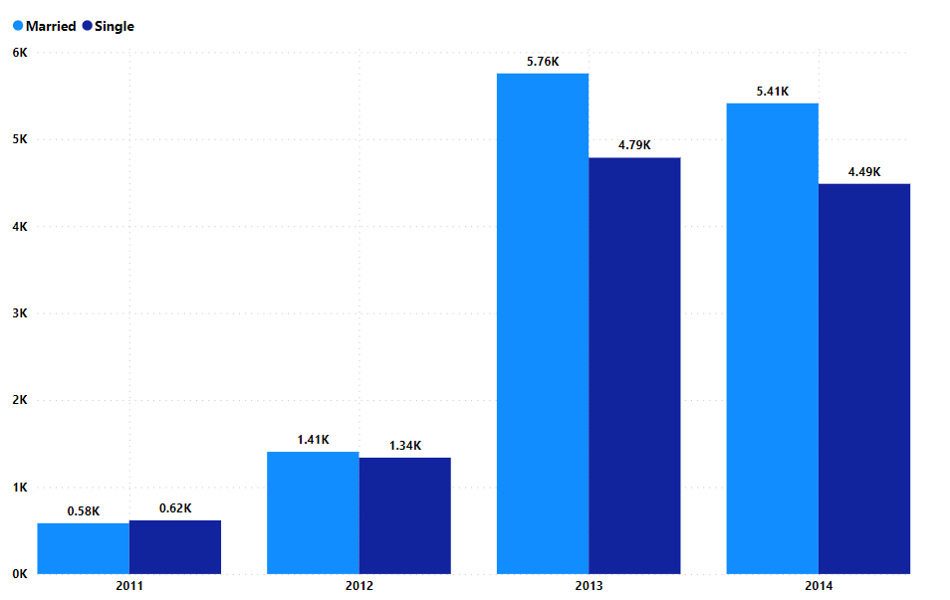
Online customer demographics: marital status
July 2013
Nov 2013
Nov 2013
Married increased by 141% between 2011 and 2012 and 310% between 2012 and 2013
Singles increased by 117% between 2011 and 2012 and 258% between 2012 and 2013
48%
June 2013
Nov 2013
July 2013
69%
248%
New market opportunity for Online channel

Slide 31
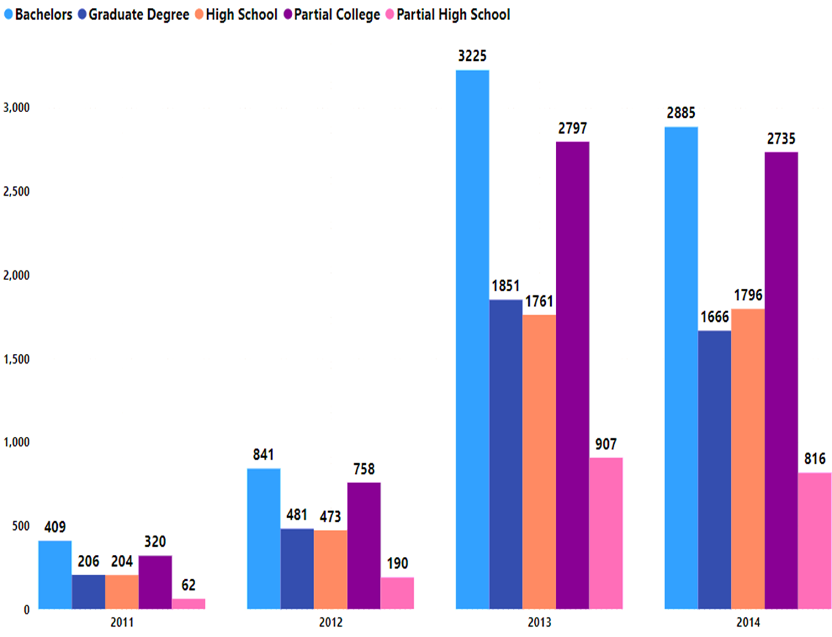
Online customer demographics: education
July 2013
Nov 2013
Nov 2013
Bachelor's degree attainment surged, with a remarkable 106% growth from 2011 to 2012 and an even more impressive 283% increase from 2012 to 2013.
48%
June 2013
Nov 2013
July 2013
69%
248%
New market opportunity for Online channel

Slide 32
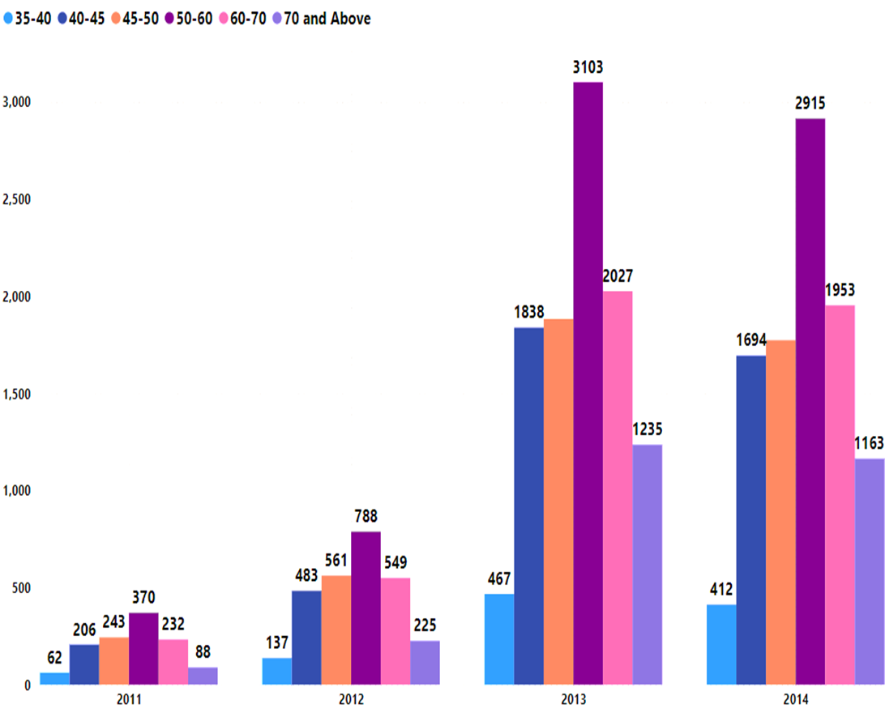
Online customer demographics: AGE
July 2013
Nov 2013
Nov 2013
The 50-60 age group demonstrated exceptional growth, with a significant 113% increase from 2011 to 2012, followed by an even more remarkable surge of 294% from 2012 to 2013.
48%
June 2013
Nov 2013
July 2013
69%
248%
New market opportunity for Online channel

Slide 33
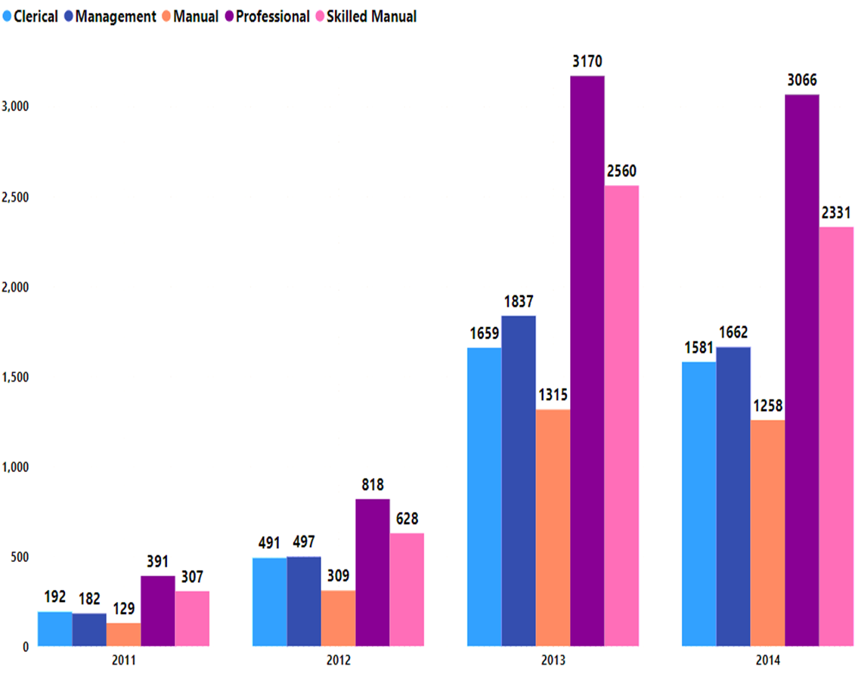
Online customer demographics: occupation
The 'Professional' occupation exhibited substantial growth, recording a noteworthy 109% increase from 2011 to 2012, and an even more remarkable surge of 288% from 2012 to 2013.

Slide 34
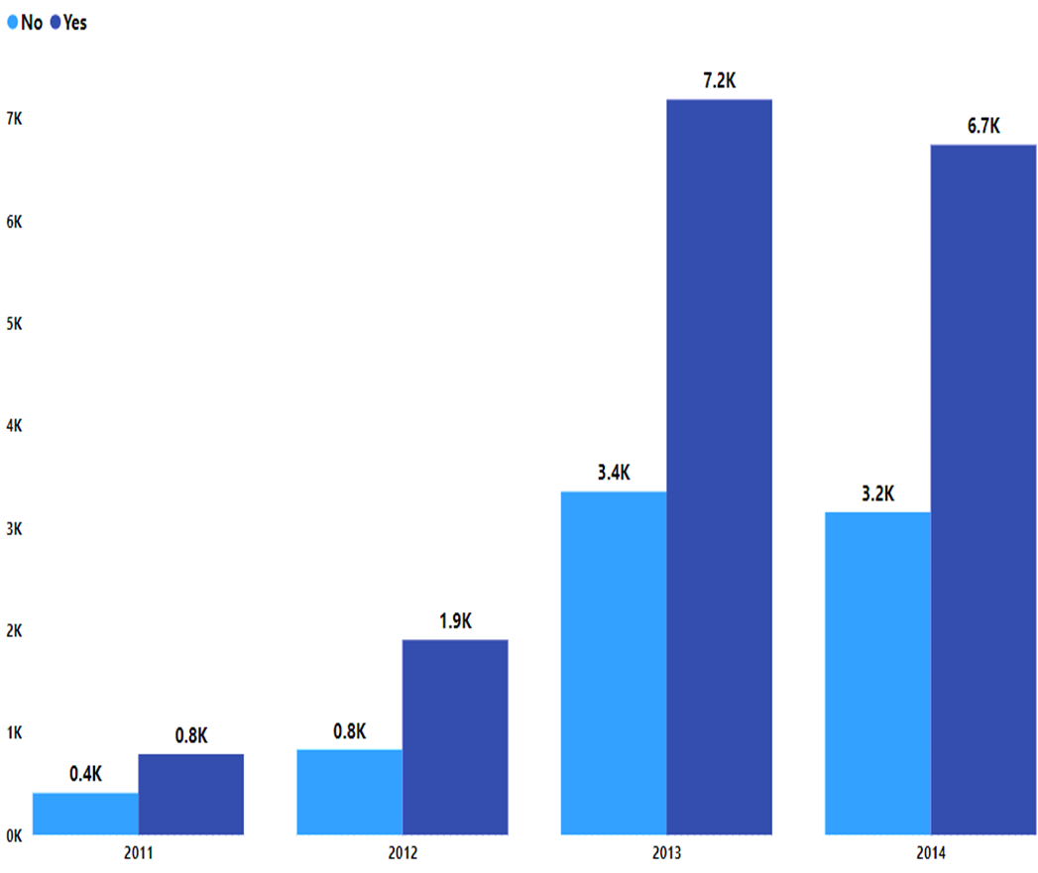
Online customer demographics: house owner
The House Owner demographic is surging, with a significant 138% increase from 2011 to 2012 and a remarkable 279% surge from 2012 to 2013.

Slide 35
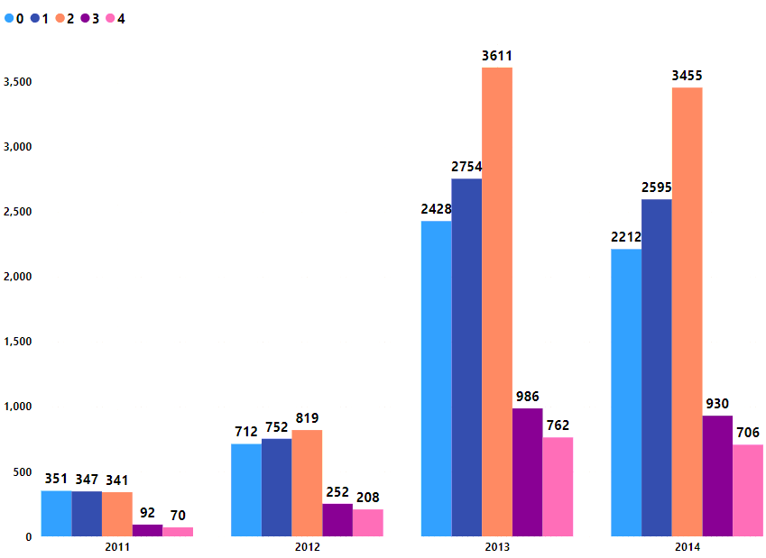
Online customer demographics: number of cars owned
The number of individuals in the "2 cars" category has significantly increased from 2011 to 2013, indicating a preference for owning two cars.

Slide 36
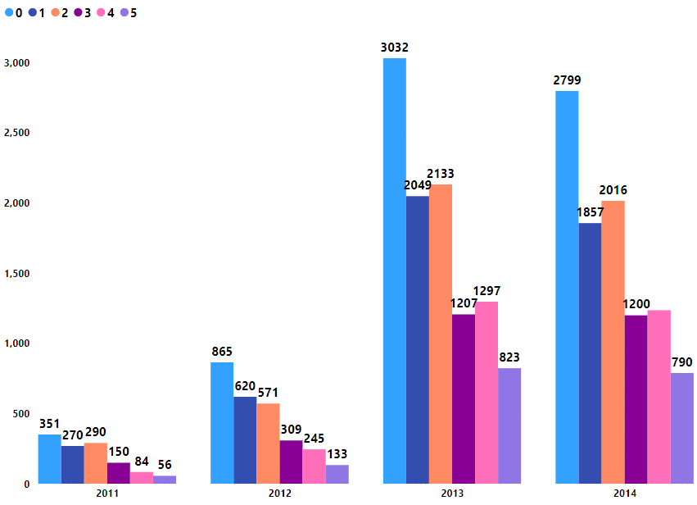
Online customer demographics: number of children
The demography is trending towards individuals with no children (0 child).
The number of individuals in this category has increased significantly from 2011 to 2013, indicating a preference for having no children.

Slide 37
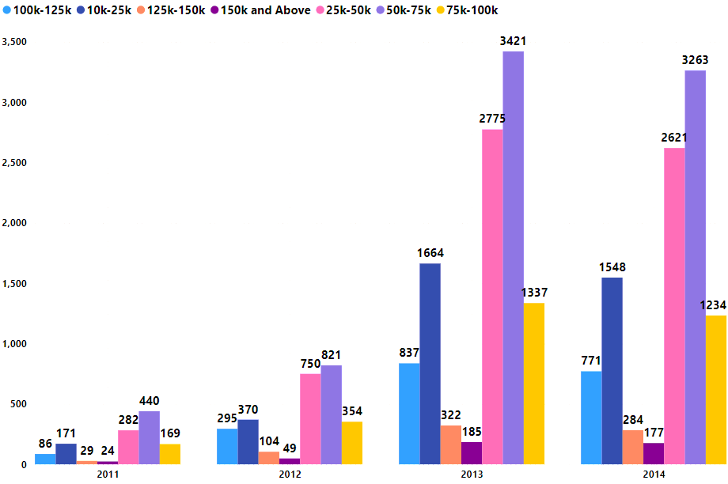
Online customer demographics: yearly income
A shift towards the "50k-75k" income group signifies changing customer income profiles over time.

Slide 38
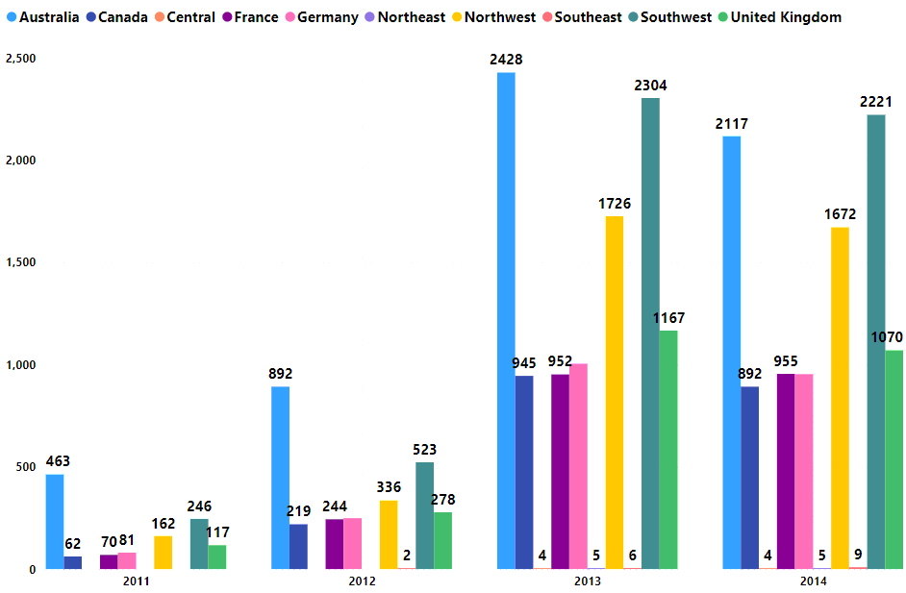
Online customer demographics: region
The demography is trending towards significant growth in online customers, primarily in regions like Australia, Canada, France, Germany, Northwest US, and the United Kingdom.
These regions have seen a substantial increase in online customers from 2011 to 2013, indicating a growing customer base.

Slide 39
Online customer demographics have notably changed from 2011 to 2013. Significant growth in both genders, married, and single customers. Higher education levels, particularly Bachelor's degrees. Trends toward ages 50-70 and white-collar professions. Increasing homeownership and car ownership. Fewer children in families and growth in the "50k-75k" income group. Specific regions, including Canada, France, Germany, Australia, the UK, Northwest US, and Southwest US, have seen substantial online customer growth.

Slide 40


Areas of improvement for ahg

Slide 41
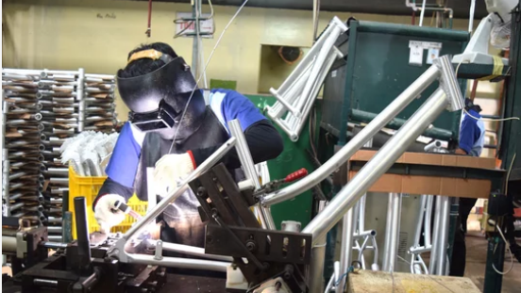
Areas of improvement for ahg
MANUFACTURING

Slide 42
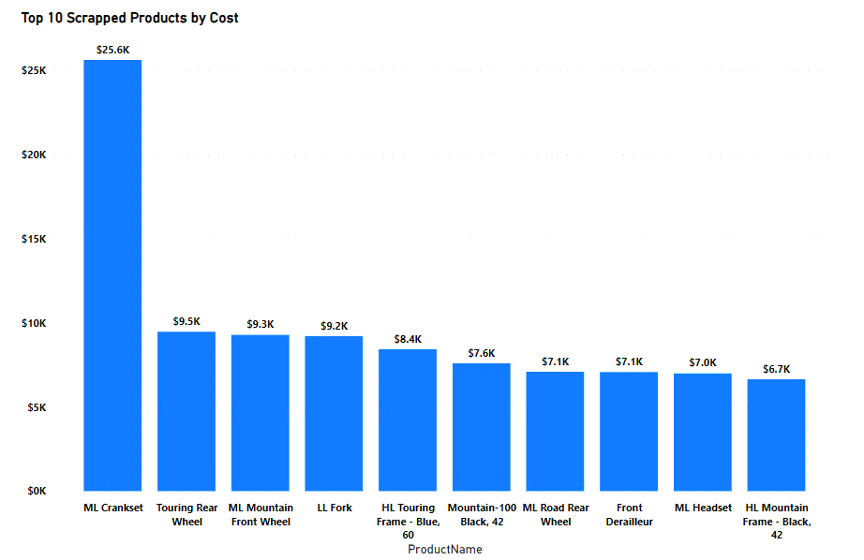
Areas of improvement – Cost of scrapped products
The sum of scrap costs for all products ranged from $6,651.369 to $25,623.36, with the ML Crankset accounting for 26.31% of the total.

Slide 43
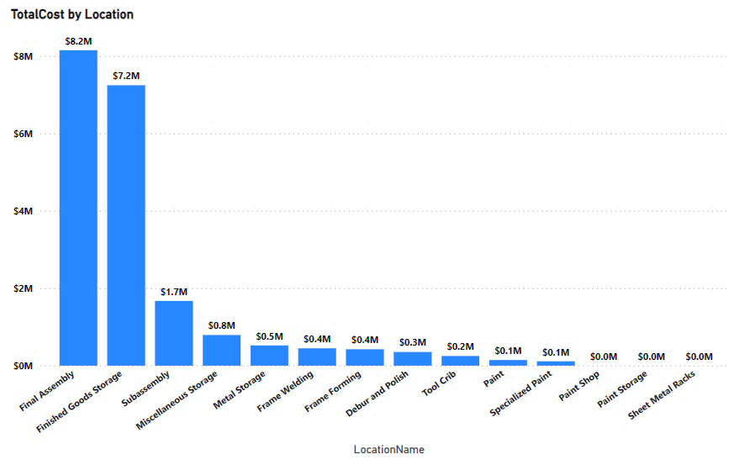
Areas of improvement – Costs at assembly locations
Total costs across 14 locations ranged from $0 to $8,151,106.18, with Final Assembly comprising 40.57% of the total.

Slide 44
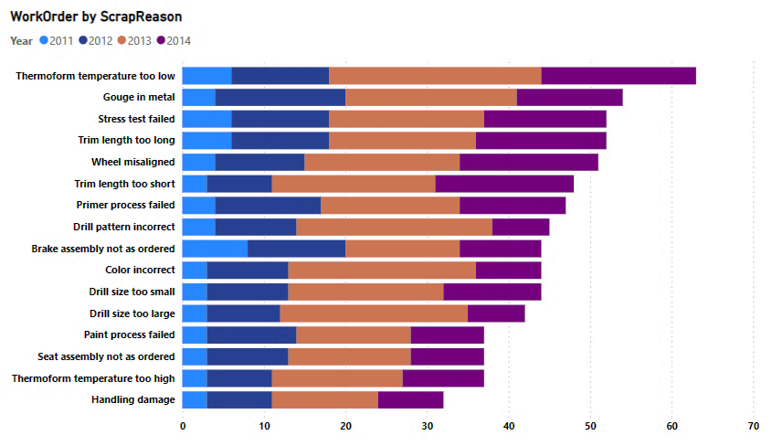
Areas of improvement – scrap reason by year
"Thermoform temperature too low" in 2013 accounted for 3.57% of the WorkOrderCount.

Slide 45
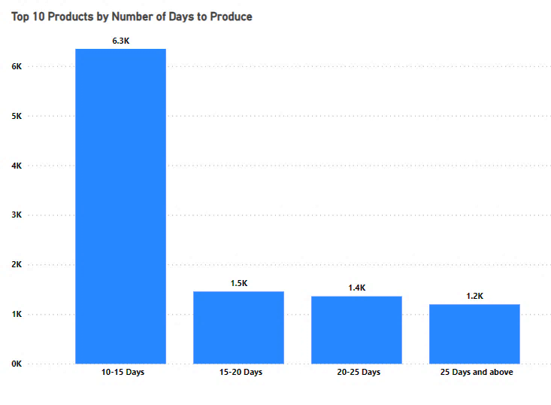
Areas of improvement – production delays (days)
61.3% of the majority of the products were produced within 10-15 days 38.7% took between 15 days and above to produce

Slide 46
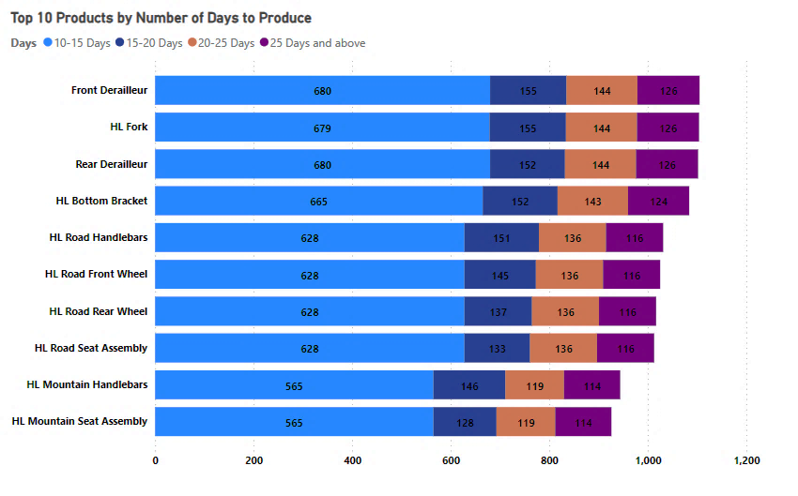
Areas of improvement – production delays (products)
‘Front Derailleur’, ‘HL Fork’, and ‘Rear Derailleur’ have the highest delay days

Slide 47

Areas of improvement for ahg
SUPPLY CHAIN

Slide 48
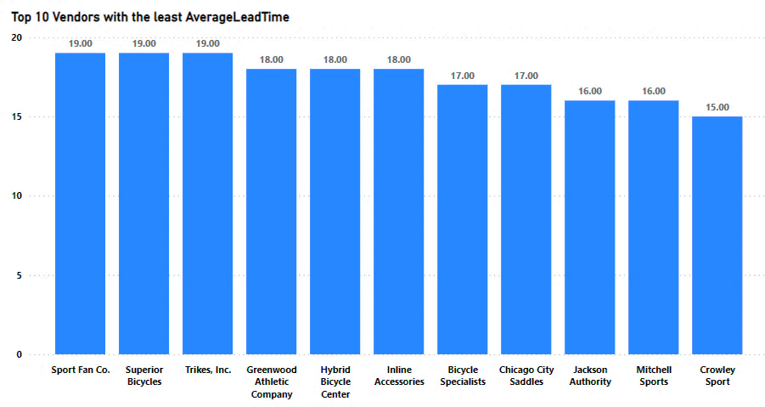
Areas of improvement – Average lead time
61.3% of the majority of the products were produced within 10-15 days 38.7% took between 15 days and above to produce

Slide 49
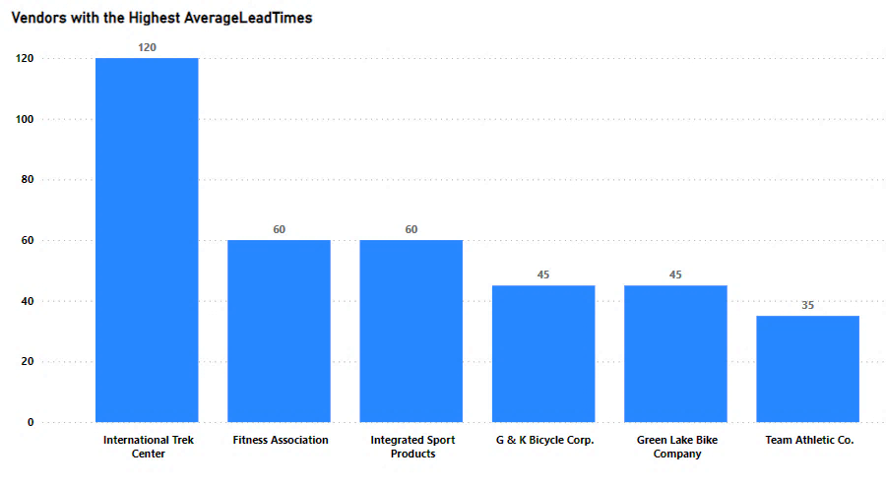
Areas of improvement – Average lead time
International Trek Center has the longest lead time of 120 days, which might indicate inefficiencies in their delivery process or a complex production process.

Slide 50
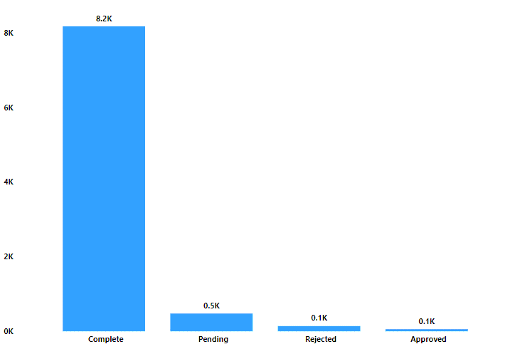
Areas of improvement – order status
Order completion increased significantly from 2011 to 2014, with a backlog of 475 pending orders in 2014.
However, the status 'Approved' only appeared in 2013 and 2014, potentially indicating delays.
Rejected orders peaked in 2013 but decreased in 2014.

Slide 51





AREAS AHG SHOULD IMPROVE
Negotiate with Vendors: AHG can Collaborate with vendors to reduce lead time delays
Order Fulfillment: AHG needs to Strengthen inter-departmental communication for order accuracy.
Efficiency in Final Assembly: AHG can optimize Final Assembly (40.57% of costs) through process, equipment, and training improvements.
06
03
05
04
02
Review Rejection Criteria: Understanding why orders are rejected or pending could help improve vendor services.
01
Quality Control for Raw Materials: AHG should focus on using high-quality raw materials to reduce scrap costs
Lean Manufacturing: AHG can implement lean principles (e.g., 5S, Kaizen, Six Sigma) for efficiency and waste reduction

Slide 52
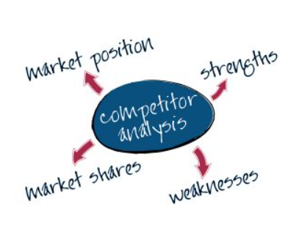

T

Slide 53
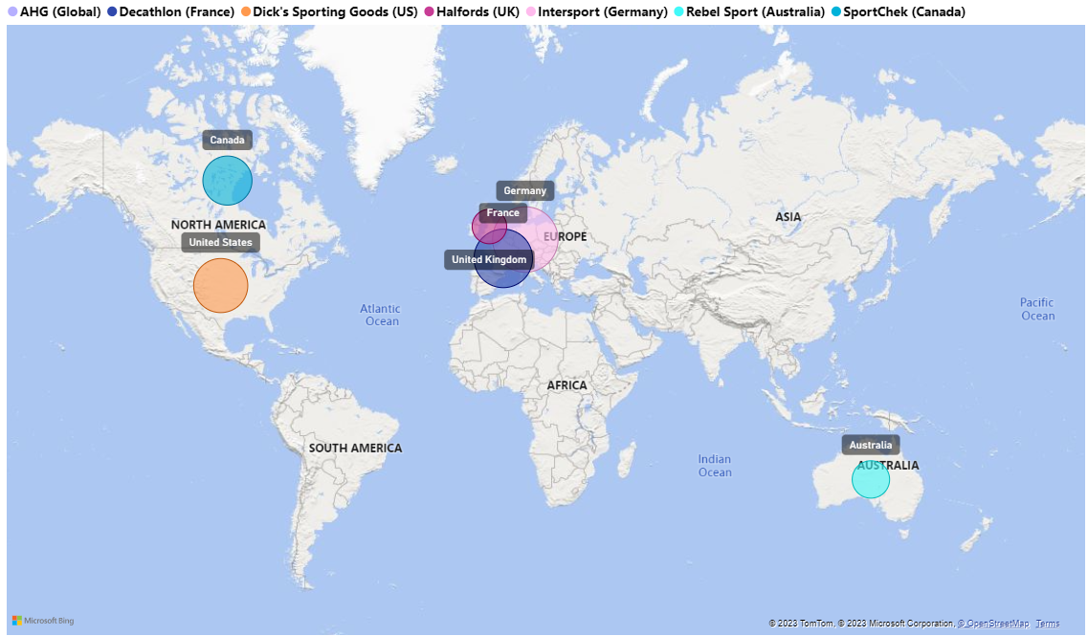






Market share and competitors: AHG’S COMPETITORS BY REGIONS
SportChek
Halfords
Intersport
T
Decathlon
Rebel Sport

Slide 54
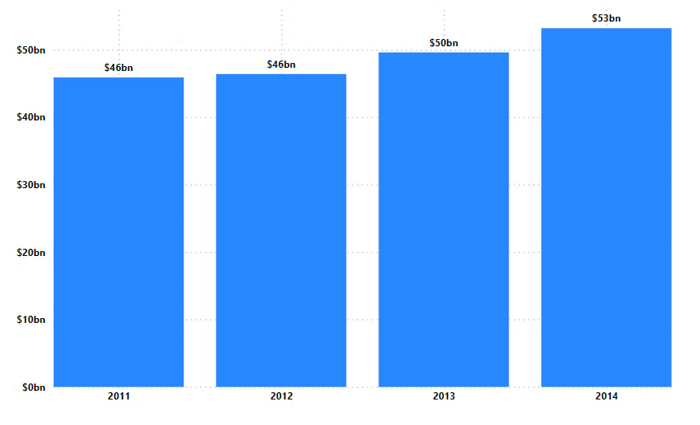
Global bike sales (2011-2014)
Global bike sales increased consistently from 2011 to 2014, rising from $45.9 billion to $53.2 billion.
The annual growth rate accelerated yearly, indicating a growing market potential, likely driven by factors like eco-friendly transportation and health trends.

Slide 55
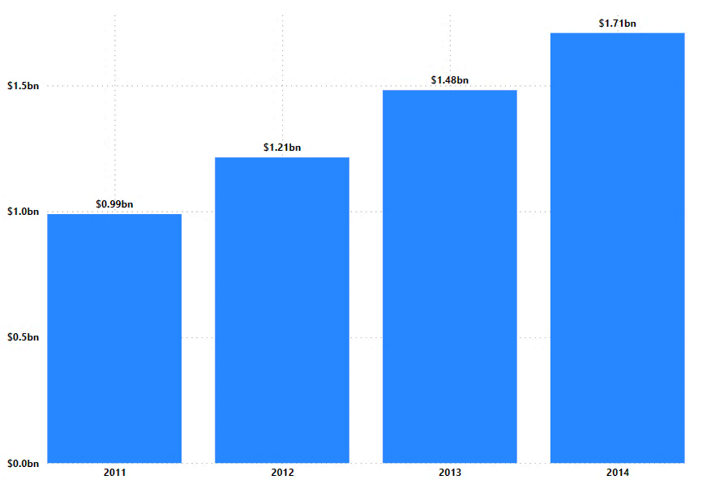
Global (online) bike sales (2011-2014)
Global online bike sales surged from $989 million in 2011 to $1.708 billion in 2014, reflecting consistent year-over-year growth.

Slide 56
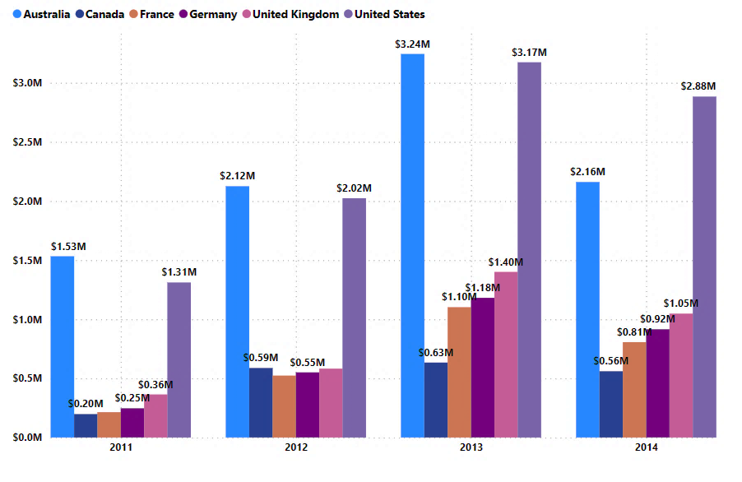
ahg bike sales (2011-2013)
AHG's online bike sales grew notably from 2011 to 2013, led by the United States ($3.17 million) and Australia ($3.24 million).
The United Kingdom reached $1.4 million, and AHG's share of Global online sales increased from 0.39% in 2011 to 0.73% in 2013.

Slide 57
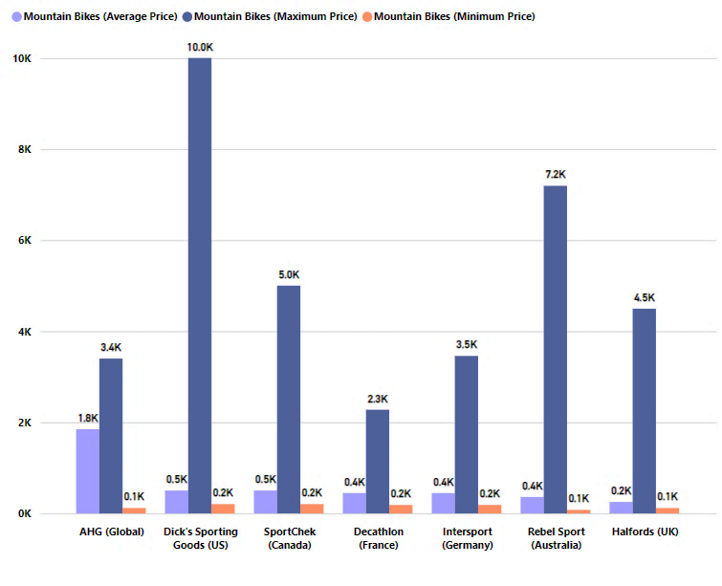
Ahg vs competitors: MOUNTAIN BIKES PRICES
AHG offers premium mountain bikes with a wide price range.
While competitors like Dick's Sporting Goods and SportChek target budget-conscious buyers, AHG competes with Decathlon and Intersport in a similar price range.
Rebel provides various budget and high-end options, while Halfords focuses on budget-friendly choices.
AHG serves the mid to high-end market and should emphasize value and quality for their premium prices.

Slide 58
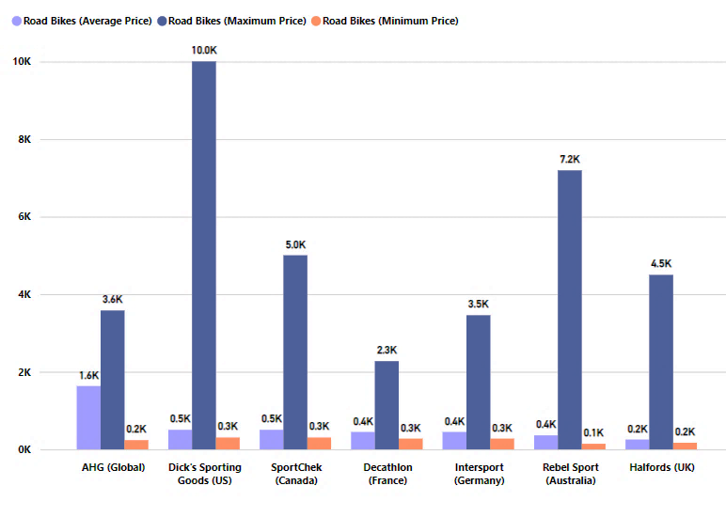
Ahg vs competitors: road BIKES PRICES
AHG's road bike prices:
Average: $1,629.62 (mid to premium range).
Maximum: $3,578.27 (high-end).
Minimum: $234.90 (entry-level).
Compared to competitors:
AHG caters to mid to premium markets.
Some competitors offer budget-friendly options.
AHG focuses on value and quality in the mid to premium range.

Slide 59
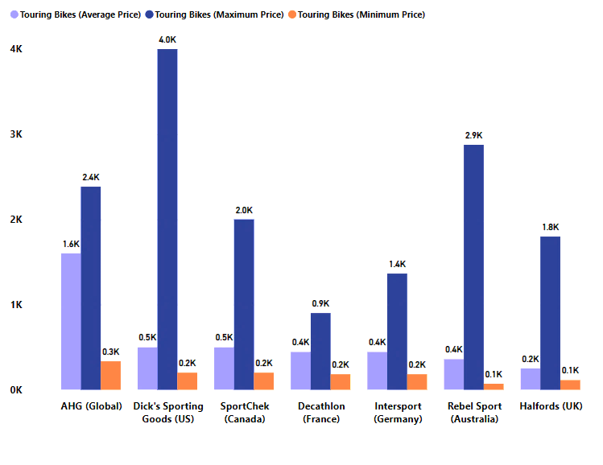
Ahg vs competitors: TOURING BIKES PRICES
AHG focuses on mid-to-premium touring bikes with an average price of $1,602.81 and a maximum of $2,384.07.
Competitors provide more budget-friendly options.

Slide 60
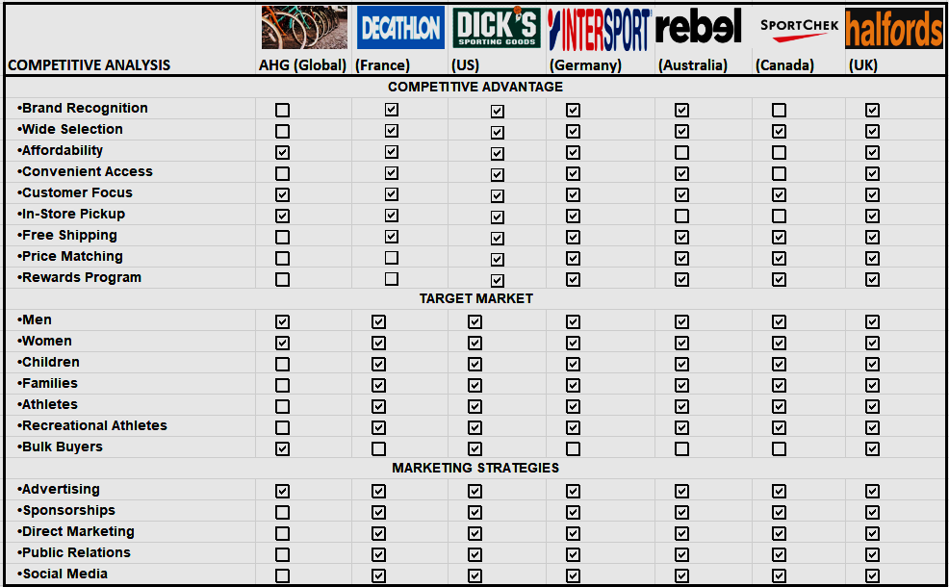
MARKET SHARE AND COMPETITORS
This competitive analysis reveals key distinctions among these brands.
AHG primarily focuses on affordability and serves bulk buyers.
Decathlon caters to a broad target market with a strong emphasis on families, athletes, and recreational athletes. Dick's Sporting Goods, Intersport, Rebel, SportChek, and Halfords offer a wide range of products for various customers.
Each brand targets a different customer segment, with its unique competitive advantages and areas of excellence.

Slide 61
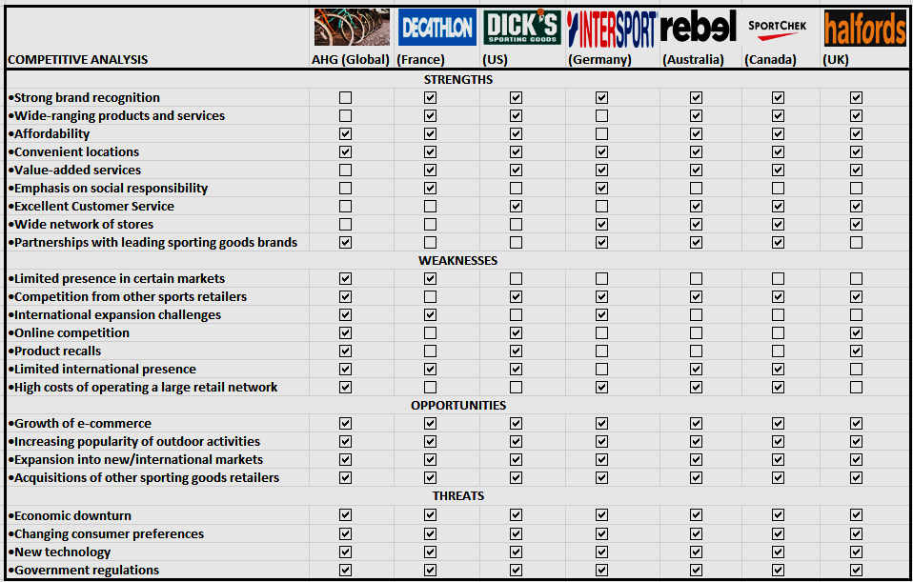
MARKET SHARE AND COMPETITORS
AHG prioritizes affordability and convenience, while competitors excel in branding, product variety, value-added services, and customer service.
Common weaknesses include limited social responsibility, network size, and lack of partnerships.
Shared opportunities: e-commerce growth, outdoor activity popularity, international expansion, acquisitions.
Common threats: economic downturn, evolving consumer preferences, new technology, government regulations.

Slide 62
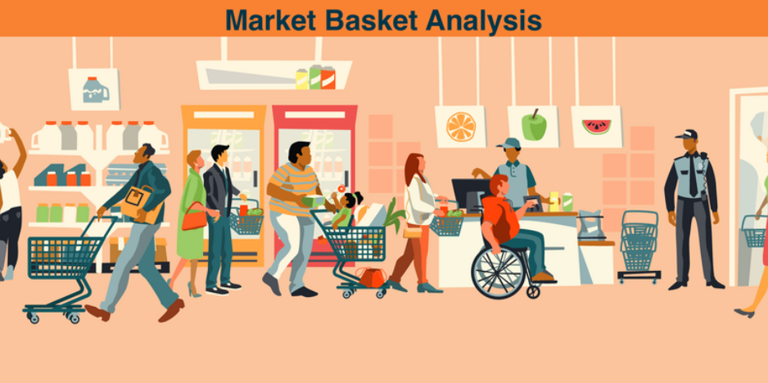

Slide 63

Cost-benefit ANALYSIS
Items frequently bought together based on Support, Confidence, lift and profitability
,

Slide 64
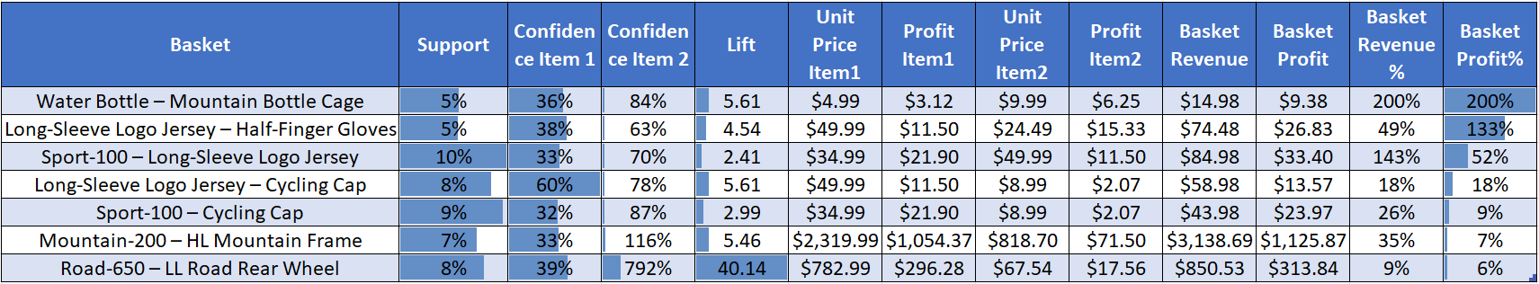
Market BASKET ANALYSIS
Top Items frequently bought together and their profitability

Slide 65
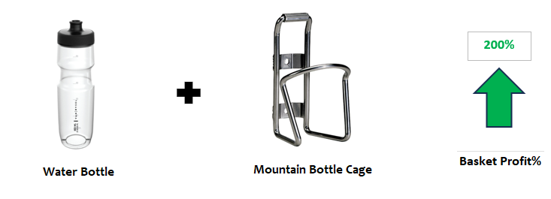

Recommended Items 1: Water Bottle & Mountain Bottle Cage
Water Bottle and Mountain Bottle Cage, with 5% support and a high lift of 5.61, supported by confidence levels of 36% and 84%. This will increase revenue from $4.99 to $14.98 (200% increase) and profit from $3.12 to $9.38 (200% increase).
Recommended Items 2: Long-Sleeve Logo Jersey & Half-Finger Gloves
Long-Sleeve Logo Jersey and Half-Finger Gloves, with 5.29% support and a lift of 4.54, supported by confidence levels of 38.96% and 62.94%. This will increase revenue from $49.99 to $74.48 (49% increase) and profit from $11.50 to $26.83 (133% increase).

Slide 66


Recommended Items 3: Sport-100 & Long-Sleeve Logo Jersey
Sport-100 and Long-Sleeve Logo Jersey, with 9.75% support and a lift of 2.41, supported by confidence levels of 33.41% and 70.38%. This will increase revenue from $34.99 to $84.98 (143% increase) and profit from $21.90 to $33.40 (52% increase).
Recommended Items 4: Long-Sleeve Logo Jersey & Cycling Cap
Long-Sleeve Logo Jersey and Cycling Cap, with 8% support and a high lift of 5.61, supported by confidence levels of 60% and 78%. This will increase revenue from $49.99 to $58.98 (18% increase) and profit from $11.50 to $13.57 (18% increase).

Slide 67


Recommended Items 5: Sport-100 & Cycling Cap
Cross-sell Sport-100 & Cycling Cap with 9% support and 2.99 lift, boosting revenue from $34.99 to $43.98 (26% increase) and profit from $21.90 to $23.97 (9% increase) at 32% and 87% confidence levels.
321%
Basket Profit%
Recommended Items 6: Mountain-200 & HL Mountain Frame
Mountain-200 and HL Mountain Frame, with 7% support and a lift of 5.42, supported by confidence levels of 33% and 116%. This will increase revenue from $2,319.99 to $3,138.69 (35% increase) and profit from $1,054.37 to $1,125.87 (7% increase).

Slide 68
Cost-benefit ANALYSIS
The cross-selling strategies outlined in the recommendations have the potential to significantly boost both revenue and profit. In some cases, the increase is as high as 200%, highlighting the value of effective cross-selling in business growth.

Slide 69


5-Year sales forecast

Slide 70


5-YEAR SALES FORECAST – UNITED KINGDOM (RESELLER & ONLINE)
$1.4M
$1.1M
$362K
$278K
RESELLER: The forecast shows a fluctuating upward trend from 2012 to 2019, reaching approximately $1.4M from $278K.
ONLINE: The forecast shows a steady upward trend from 2011 to 2019, reaching approximately $1.1M from $362K.

Slide 71


5-YEAR SALES FORECAST – SOUTHWEST (RESELLER & ONLINE)
1.1M
$1.4M
$1.3M
362K
$491K
$286K
RESELLER: The forecast shows a fluctuating upward trend from 2011 to 2019, reaching approximately $1.3M from $286K.
ONLINE: The forecast shows a steady upward trend from 2011 to 2019, reaching approximately $1.4M from $491.5K.

Slide 72


5-YEAR SALES FORECAST – SOUTHEAST (RESELLER & ONLINE)
$13K
$150K
$2.5K
$55K
RESELLER: The forecast is trending downwards from 2011 to 2019, reaching approximately $55K from $150K.
ONLINE: The forecast shows a fluctuating upward trend from 2011 to 2019, reaching approximately $13M from $2.5K.

Slide 73


5-YEAR SALES FORECAST – NORTHWEST (RESELLER & ONLINE)
$1.5M
$1M
$387K
$239K
RESELLER: The forecast is fluctuating upwards from 2011 to 2019, reaching approximately $1.5M from $239K.
ONLINE: The forecast shows a fluctuating upward trend from 2011 to 2019, reaching approximately $1M from $387K.

Slide 74


5-YEAR SALES FORECAST – NORTHEAST (RESELLER & ONLINE)
$4K
$513K
$2K
$169K
RESELLER: The forecast is fluctuating upwards from 2011 to 2019, reaching approximately $513K from $169K.
ONLINE: The forecast shows a fluctuating upward trend from 2013 to 2019, reaching approximately $4K from $2K

Slide 75


5-YEAR SALES FORECAST – GERMANY (RESELLER & ONLINE)
$953K
$84K
$330K
-$742K
RESELLER: The forecast is fluctuating downwards from 2013 to 2019, reaching a loss of approximately -$742K from 84K.
ONLINE: The forecast shows a fluctuating upward trend from 2011 to 2019, reaching approximately $953K from 330K.

Slide 76


5-YEAR SALES FORECAST – FRANCE (RESELLER & ONLINE)
$1M
$984K
$282K
$106K
RESELLER: The forecast is fluctuating upwards from 2012 to 2019, reaching approximately $1M from 106K.
ONLINE: The forecast shows a fluctuating upward trend from 2011 to 2019, reaching approximately $984K from 282K.

Slide 77


5-YEAR SALES FORECAST – CENTRAL (RESELLER & ONLINE)
$574K
$157K
$172K
-$7.4K
$106K
RESELLER: The forecast fluctuates from 2011 to 2019, reaching approximately $574K from $172K.
ONLINE: The forecast shows a fluctuating downward trend from 2013 to 2019, reaching a loss of $7,449 from $157.

Slide 78


5-YEAR SALES FORECAST – CANADA (RESELLER & ONLINE)
$498K
$860K
$235K
$298K
RESELLER: The forecast fluctuates from 2011 to 2019, reaching approximately $860K from $298K.
ONLINE: The forecast shows a fluctuating upward trend from 2011 to 2019, reaching approximately $498K from 235K

Slide 79


5-YEAR SALES FORECAST – AUSTRALIA (RESELLER & ONLINE)
$1.26M
$71K
$558K
-$495K
$298K
RESELLER: The forecast is fluctuating downwards from 2013 to 2019, reaching approximately -$495K from $71K
ONLINE: The forecast shows a fluctuating upward trend from 2011 to 2019, reaching approximately $1.26M from $558K

Slide 80

5-year sales forecast
The performance of reseller and online sales channels varies significantly across different regions, with success dependent on the specific region's unique market dynamics.

Slide 81


AHG STRATEGY

Slide 82







AHG STRATEGY
Collaborations and Partnerships:
Form partnerships with retailers or distributors to expand distribution channels and collaborate with other brands for joint marketing efforts.
Leverage Success and Expand Online: AHG should capitalize on Australia’s success and expand its online presence with user-friendly digital platforms.
Product Innovation: Develop new, innovative products that meet changing customer needs and preferences. This could include electric bikes, foldable bikes, or bikes with unique features.
Consider sustainable practices that may also attract environmentally conscious consumers
Optimize Product Mix and Pricing: AHG should emphasize high-profit-margin products like Accessories, Bikes, and Clothing, and adjust pricing strategies.
Customer Engagement:
Enhance customer engagement through a robust online presence, loyalty programs, and after-sales services to boost retention.
Target Customer Demographics and Enhance In-Store Experience: Focus on the 30s and 40s age group and improve in-store experience.
Operational Efficiency: Streamline manufacturing processes to reduce costs. Streamline the supply chain for cost-effectiveness and timely production.

Slide 83
Recommendations
Leverage Physical Locations:
AHG should retain resellers/stores across all regions, utilizing them as more than “pick-up points” for online purchases, but for brand visibility, personal customer experience, and easier returns/exchanges. This strategy can bridge the gap between online and offline shopping experiences.
Expand Service Offerings:
Implementing aftersales services, maintenance services, and spare parts for all types of bikes and cars can create ongoing revenue streams in-store. This can enhance customer loyalty and increase repeat business.
Extend Online Product Range:
Components, which are currently sold in-store, should also be made available on the online channel. This can cater to a wider customer base and drive online sales.
Implement Market Basket Analysis Recommendations:
The insights from the market basket analysis should be applied both online and in-store. This can optimize product recommendations, encourage cross-selling, and increase the average transaction value.

Slide 84
conclusion
In conclusion, AHG's growth and profitability are driven by its online channels. However, reseller performance varies, suggesting a need for a region-specific approach.
Non-discounted sales outperform discounted ones, indicating a potential reevaluation of the discount strategy.
The changing online customer demographics present new opportunities for targeted marketing.
The potential of cross-selling strategies to boost revenue and profit significantly should be leveraged.
AHG should focus on enhancing its online presence, optimizing its product mix, targeting customer demographics, analyzing profitability, leveraging cross-selling insights, and exploring new markets.

